Slide 1




Module Name - Abstraction & Encapsulation
Class - Day 1
Topic Name- Classes & Objects
EditEdit MasterMaster texttext stylesstyles

Slide 2
Time Allocation Summary
Element | Slide numbers | Maximum time allowed (min)
Today’s Agenda | 4 | 5
Introduction to OOPs | 5-13 | 8
Advantages of OOPs | 14-16 | 5
Introduction to Class | 17-21 | 10
Class: Example | 22-27 | 10
Notions of Classes | 28 | 2
Concept of Multiple Classes | 29-31 | 5
Introduction to Objects | 32-34 | 5
Classes & Objects | 35-40 | 10
Concept of Multiple Objects | 41-44 | 10

Slide 3
Time Allocation Summary
Element | Slide numbers | Maximum time allowed (min)
Multiple Objects in a Class: Application | 45-54 | 15
Introduction to Constructor | 55-60 | 10
this Keyword | 61-63 | 10
Types of Constructors | 64-68 | 10
Summary | 69-70 | 5
Total |  | 120

Slide 4
Today’s Agenda
Introduction to OOPs
Advantages of OOPs
Introduction to Classes
Concept of Multiple Classes
Introduction to Objects
Concept of Multiple Objects
Constructor & Its Types
Use of this Keyword

Slide 5

Introduction to OOPs
At times in the code, there is a functionality which needs to be used repetitively and to be shared with different teams.
Consider the case of Ola app.
Suppose there are 3 different teams working for
Ola Select,
Ola Share
Ola Cafe.

Slide 6
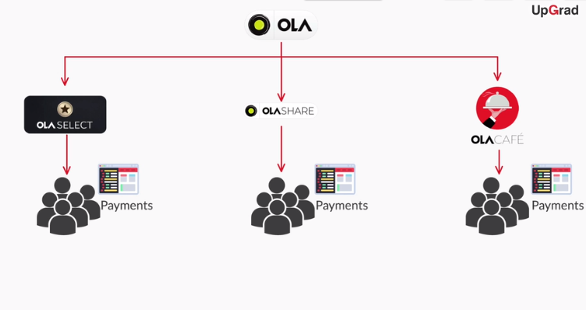
Introduction to OOPs
Now every team has to work on writing the user code for payments services. So, do you think each of them write a separate code for implementing payments? Will that be the most efficient way to build the product?

Slide 7
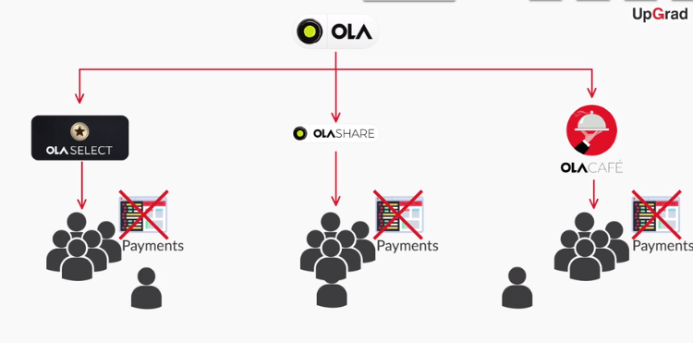
Introduction to OOPs
The ans is NO. Instead of writing the codes separately one team will write the code which can be used by other teams..

Slide 8
Introduction to OOPs
Now, it will be tedious to write separate codes for payment functionality in these three sub parts of the app.
It will be easy if the code for payment functionality is written once and then used by different teams for their sub parts.

Slide 9

Introduction to OOPs
Different projects are broken into small
entities or modules where one particular
team works on one module.
These independent modules can be used
by other teams as well.
This is where Object Oriented Programming
comes into play.

Slide 10
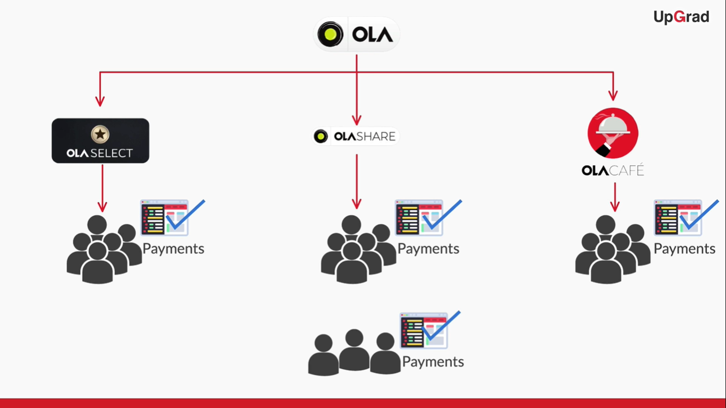
Introduction to OOPs

Slide 11
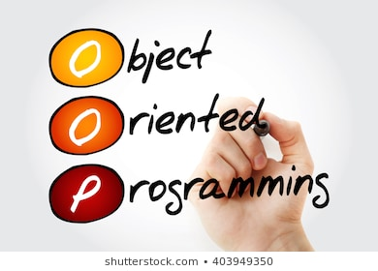
Introduction to OOPs
What is OOPs?
OOPs or Object Oriented Programming gives you a particular methodology for implementing large and
complex programming projects in a very
simple way.
It uses structure of classes and objects.

Slide 12
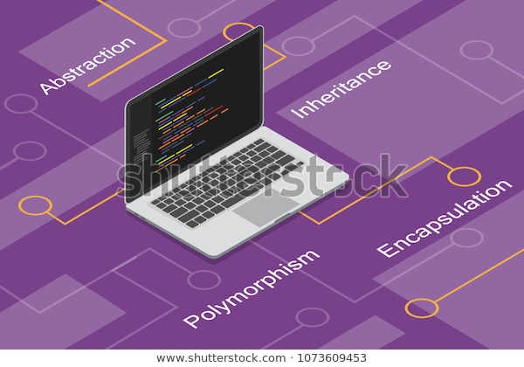
Introduction to OOPs
Four Principles of Object Oriented Programming
Abstraction
Encapsulation
Inheritance
Polymorphism

Slide 13

Introduction to OOPs
There are some programming languages which do not follow the concepts of OOPs and are known as Procedural programming language.
However, these general purpose
programming languages like Java,
C++, C#, Python etc are OOPs based
programming languages.

Slide 14

Advantages of OOPs
Benefits of OOPs
Building a new project becomes more
organised and efficient.
For example if the team is implementing a
Payments structure for an online product
It would be more efficient to implement it
in independent module.

Slide 15
Advantages of OOPs
Real world scenarios can be implemented naturally.
- For example in the payments module there can be different modes of payment like credit card, debit card, digital wallets and digital banking. So, the team implementing these payment options in the module, each payment mode has to be implemented by different engineers.

Slide 16
Advantages of OOPs
Modification and update of program becomes easier.
For example if you want to add a new mode of payment then you just have to add a new sub module only once in the payment module and you don’t need to do it separately for every different service. Also suppose that the debit card payments are not working properly. So, we know which sub module we have to look at instead of looking at the entire code.

Slide 17

Introduction to Class
What is a class?
A class is a blueprint of an application where you:
Implement methods to perform certain actions/functionalities
Declare variables that describe the properties of the application

Slide 18
Introduction to Class
The whole idea behind classes is to have independent modules in the program, each class representing one particular entity.
That entity can have various
data members, variables, and
methods linked to it.
class1{ .... }
class2{ .... }
class3{ .... }

Slide 19
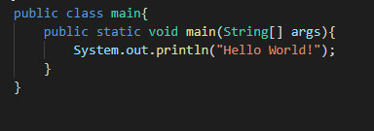
Introduction to Class
And as a good practice, the public static void main method is kept in a separate class named Main.

Slide 20

Introduction to Class
You can have a different name for the
class that contains the main method.
However, the name of the Java file has
to be the same as the name of that
particular class.
Whenever you need to assign values to
the variables of a particular class, or
call the methods of that class, you can
do it in the main method.

Slide 21
Introduction to Class
Since variables/methods are declared in a different class, and accessed/called in a different class, you need to use the dot operator to do this.
Using . operator
class1{ .... }
class2{ .... }

Slide 22
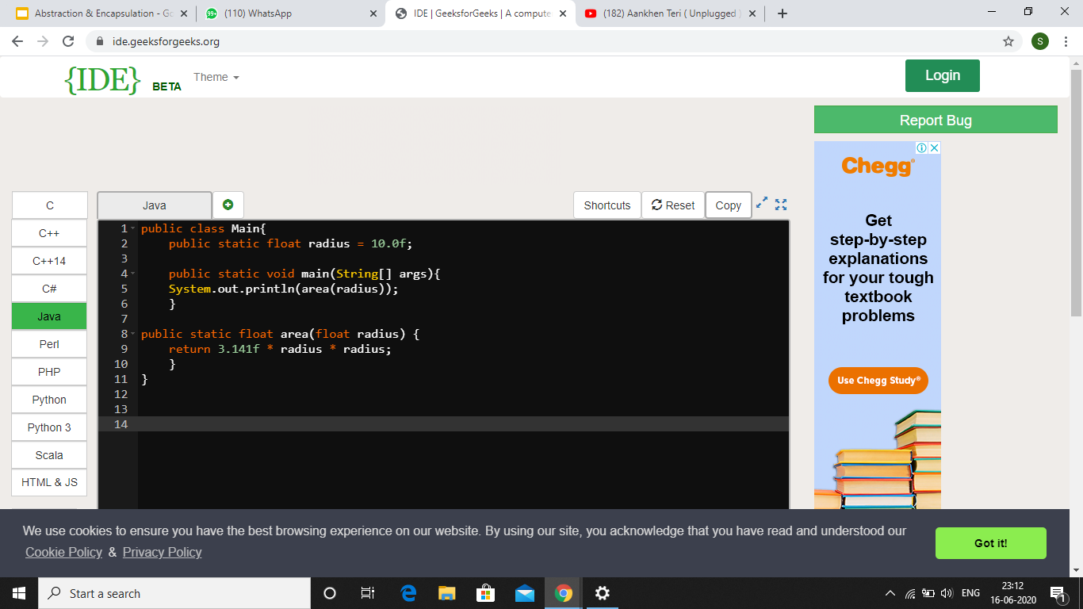
Class: Example
Class: Example

Slide 23
Class: Example
There are two methods in the main class: main method & area method.
main method
area method

Slide 24

Class: Example
Other than that, a float variable called radius
is declared in this class whose value is 10.0f.
radius variable

Slide 25
Class: Example
Area method is of type float and also takes a
single argument which is also a float value.

Slide 26
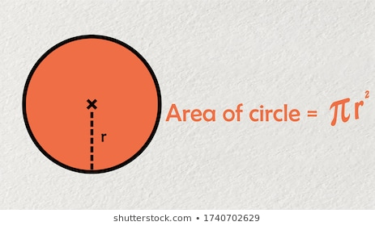
Class: Example
The argument is basically value of radius and the area method returns the area of circle when called.
It is returning us 3.14*R*R which is basically the area of the circle where R= radius.

Slide 27
Class: Example
Area method is called in the main method by passing radius variable as parameter.
And the returned value is printed.

Slide 28
Notions of Classes
Notions of Classes
One can have multiple classes in the same program.
Only one of the class can be public in a Java File.
Dot is used to call a method from another class.
The public class which we have created should be the same as the name of our file which we have saved.
Notes:
Significance of public to be taught later

Slide 29

Concept of Multiple Classes
Need for Multiple Classes
Suppose, you want to find area of another shape.
Now, you cannot have two methods with exactly
the same name and same parameters in a
single class.
If we have two methods of the same name then it will lead to the name clash and our code will throw us error.

Slide 30
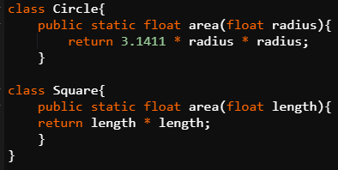
Concept of Multiple Classes
You have to put those methods in two different classes.

Slide 31
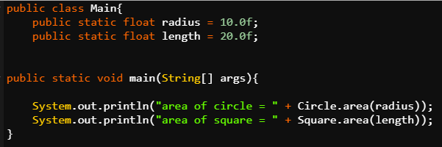
Concept of Multiple Classes
This is how these two area methods can be called.
By doing this we can avoid the name clashes and we can use the same method name to be used in several classes.

Slide 32

Introduction to Objects
Till now, you were introduced to classes and used classes as separate independent modules, i.e. used classes as a module-creation mechanism.
Time to get introduced to objects and see
more real benefits of classes.

Slide 33
Introduction to Objects
What are Objects?
If we consider the real-world, we can find many objects around us, cars, dogs, humans, etc. All these objects have a state and a behavior. If we consider a dog, then its state is - name, breed, color, and the behavior is - barking, wagging the tail, running.
Software objects also have a state and a behavior. A software object's state is stored in fields and behavior is shown via methods.

Slide 34

Introduction to Objects
Methods from different classes are called
using object only. The approach which we
used earlier to call the methods is not a
good practice and some changes are
required in that code.

Slide 35
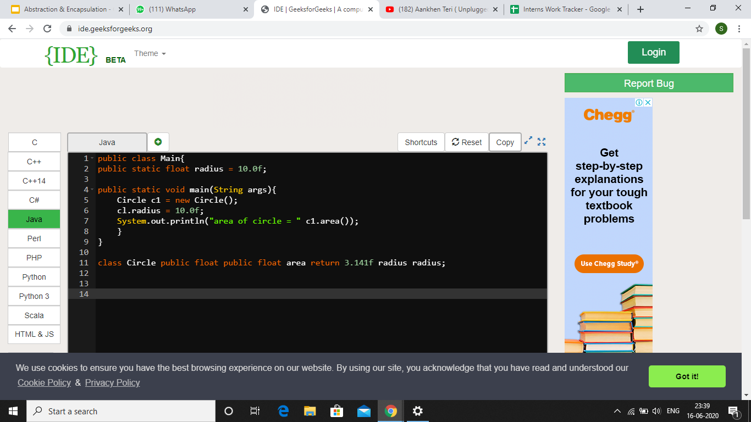
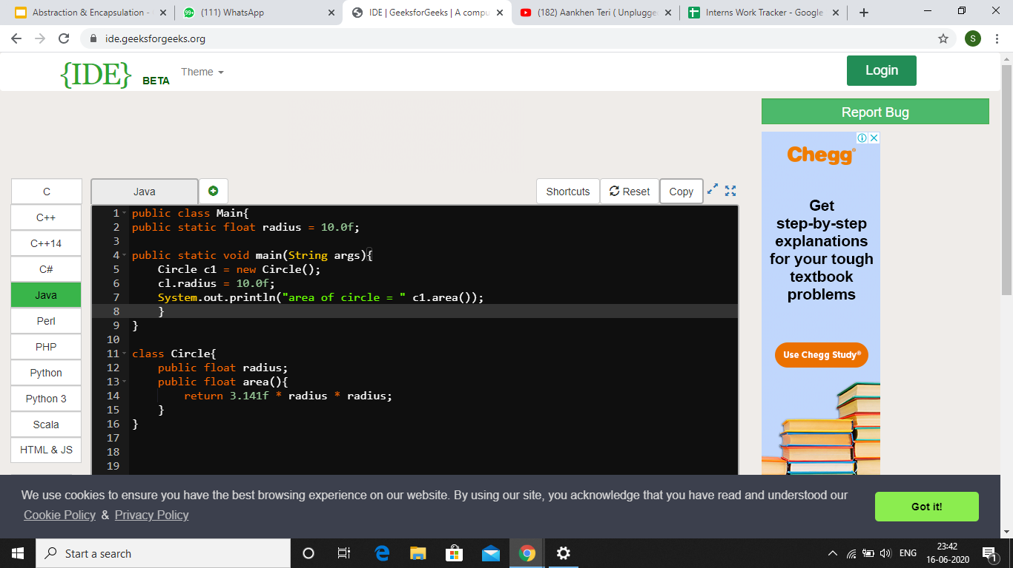
Classes & Objects

Slide 36

Classes & Objects
Changes to be made to create objects from classes: Area Example Updated
Declare the radius attribute in the
Circle class.

Slide 37
Classes & Objects
Remove the static keyword from attributes and methods.
No static keyword written before radius attribute and area method

Slide 38
Classes & Objects
Delete the parameter from the declaration of area method. This means that the radius inside the body of this area method now refers to the radius attribute inside circle class and not the radius which was earlier passed as parameter.
No parameter inside area method.

Slide 39
Classes & Objects
Create an instance(object) of the Circle class inside the main method.
Circle c1 = new Circle() // c1 object of class circle
Basically, Circle can be seen as a type and c1 as its variable.

Slide 40
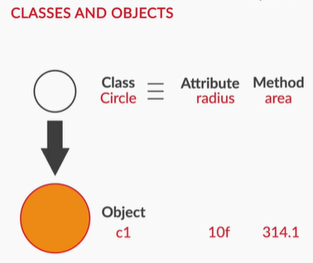
Classes & Objects
Call area method using c1.area().
Assign value to radius attribute of
circle class using c1.
c1.radius = 10f;
So, basically what object does is that
allows one to access the attributes and methods of a class outside that class.

Slide 41
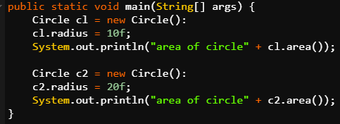
Concept of Multiple Objects
Multiple objects can be created for the same class.
Each object can set their own values for the attributes and call the method with those values into consideration.

Slide 42
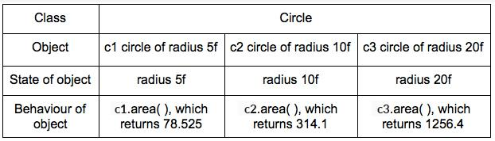
Concept of Multiple Objects
What is state and behaviour of an object?
The state of an object refers to the specific values of the variables of the class the object belongs to.
The behaviour of an object refers to the action performed by the object when called by a particular method from the class.

Slide 43

Concept of Multiple Objects
Relation between a Class and its Object
Let’s take another example of a house class to understand this better. Suppose that an architect designs a blueprint for a house.
This same blueprint can then be used to build multiple houses.
A single blueprint is useful to build several houses that have the same architecture.

Slide 44
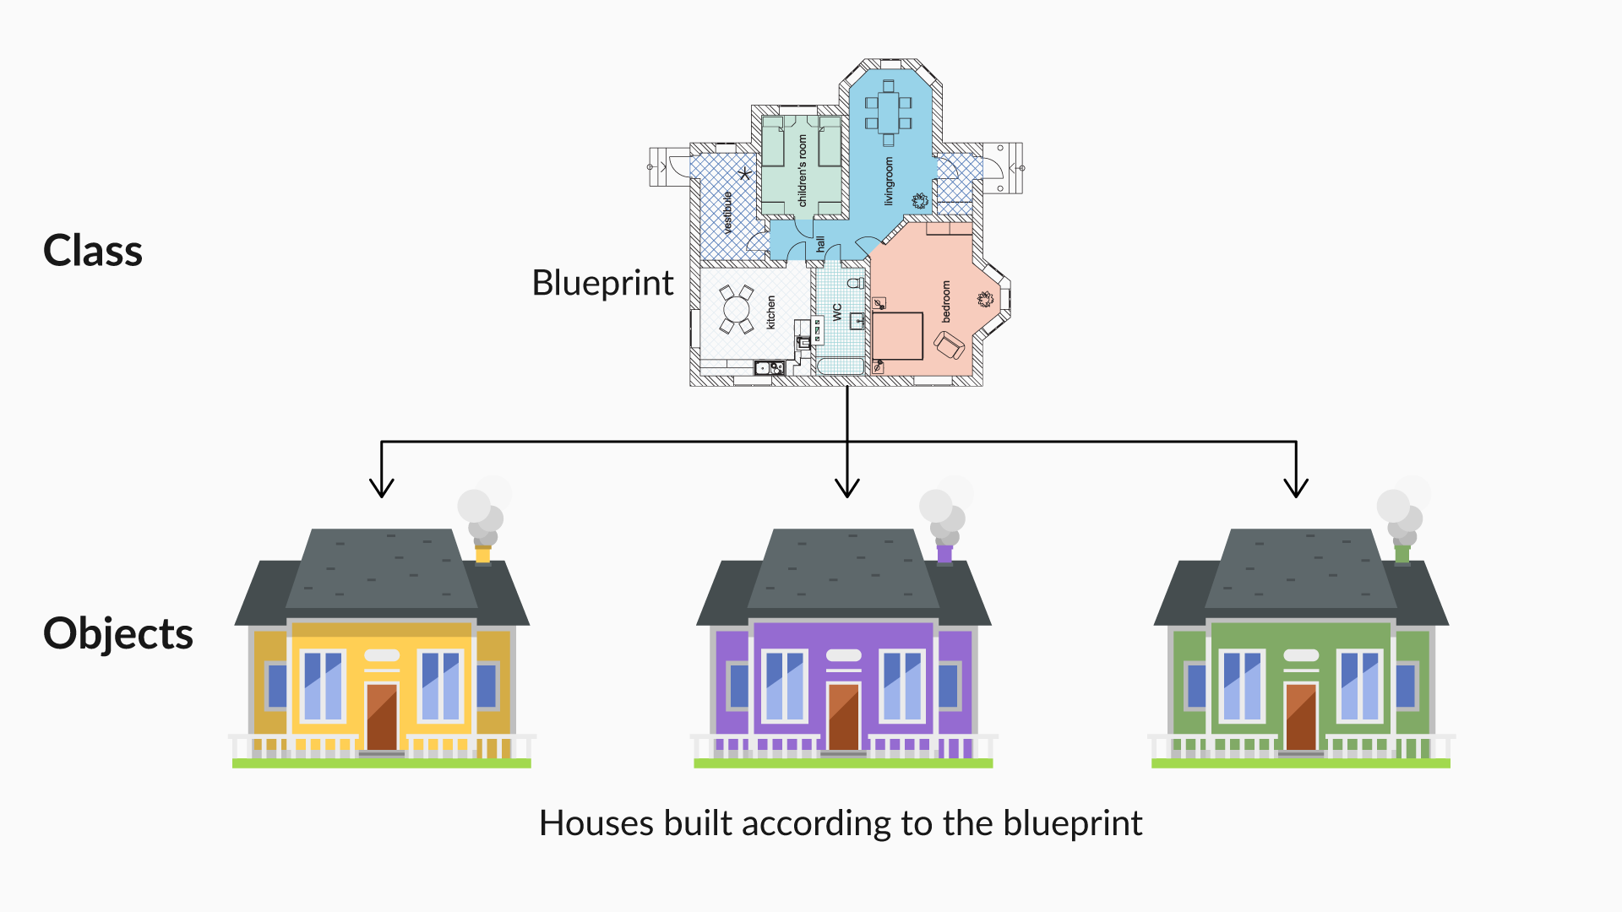
Concept of Multiple Objects
The concept of classes and objects is similar to this. Here, the house blueprint
acts as a class
and a particular
house represents
the object.

Slide 45

Multiple Objects in a Class: Application
You have already been introduced to the concept of multiple objects of a class.
It’s time to see how this concept is practically used to solve various purposes.

Slide 46

Multiple Objects in a Class: Application
Let us take a new example of a class named
Student in a software system like a university’s
information management system.
Student Class:
Variables: Name, Roll number, CGPA
Methods: Edit profile, Register for a
new course, Submit assignment, Check
result

Slide 47

Multiple Objects in a Class: Application
For the Student class, your objects would be different students — s1, s2, s3 — with names such as
Prateek, Ankit, and Ajay.
There can be thousands of objects, where
each object has all the characteristics of the
Student class.

Slide 48

Multiple Objects in a Class: Application
Instances: An object of a class is also referred to as an instance. The word “object” or “instance” can be interchangeably used.
For example, s1, s2, s3, etc. are all
instances or objects of the Student class.

Slide 49
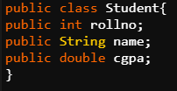
Multiple Objects in a Class: Application
Instance variables: Instance variables are variables from the class, which become the characteristics (or states) of the objects/instances. Every object has its own copies of instance variables.
For example, roll number, name, CGPA are all
instance variables of the Student class which
will Become characteristics of student object like student objects S1 with rollno-1, cgpa-8 and name-Varsha and S2 with rollno-2, cgpa-9 and name-Pratik.

Slide 50
Multiple Objects in a Class: Application
An information system can have more than one class.
As we have seen the student class here there can be other classes also like professors, faculty etc.
A class can have multiple attributes.
We have rollno, cgpa and name as attributes of student class.

Slide 51
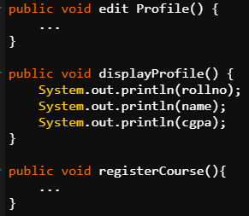
Multiple Objects in a Class: Application
A class can have multiple methods
Class can have different functions inside it as in student class we have displayProfile and registerCourse as two methods.

Slide 52
Multiple Objects in a Class: Application
.
Multiple objects can be created for a single class
The student class can be used to create various student objects like s1 with rollno-1, cgpa-8 and name-Varsha and S2 with rollno-2, cgpa-9 and name-Pratik.

Slide 53
Multiple Objects in a Class: Application
State and behaviour of instances:
Specific values assigned to these
variables for a given instance is
represented as the state of that
object/instance, calling the methods
would be represented as the behaviour
of that instance.

Slide 54
Multiple Objects in a Class: Application
Modelling Real-Life Scenarios Using Classes and Objects
University Information Management System:
Classes
a. Student
b. Professor
c. Course
Methods
a. OfferCourse() in Professor class
b. RegisterCourse() in Student class
Objects
a. Prof. Sujit, Prof Tricha for Professor class
b. Compilers, Internet of things for Course class

Slide 55

Introduction to Constructor
Now, you know how to create and use objects in your code. So, it’s time to get introduced to constructors, which will help you create classes in a more efficient way.

Slide 56

Introduction to Constructor
What is a Constructor?
Constructor is a special type of method used
to initialize an object of a class and define
values of the instance variables of the object.
You can call a Java constructor while creating
a new object. It constructs the values for the instance variables, i.e. provides data for the object. This is why it is known as a constructor.

Slide 57
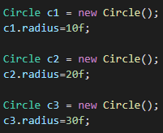
Introduction to Constructor
We see that everytime we are creating an object for
a class we have to do this laboursome activity of
initializing its variables to a particular value (like
radius here in the above example for Circle class).
Here we are declaring three objects for Circle class and we have to initialize
its radius everytime.

Slide 58
Introduction to Constructor
The fact that we have to do this as 2 seperate instructions in our code to make our code particularly error prone but there can be an instance where you can forget to initialize the radius attribute of any object to a particular value. This is not desirable to us which makes this practice inefficient.
So we need to have some mechanism to ensure that any object creation out of a class is done using a safe and efficient mechanism.

Slide 59

Introduction to Constructor
Constructor will initialize the value of Circle variable radius as soon as object of Circle class is created.
So, there is no need to initialize the value of radius again and again when the object is created.
Constructor of class Circle

Slide 60
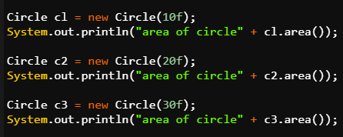
Introduction to Constructor
Rather, the values for radius variable for different objects can be passed as parameters while creating the objects.
These values act as an argument to constructor method.

Slide 61

this Keyword
this Keyword
The 'this' keyword is often used in classes to refer to instance variables.
The 'this' keyword is used to distinguish the instance variables from parameters that have the
names as the instance variable,
and makes declaring of a constructor
easier.

Slide 62
this Keyword
The 'this' keyword is used to refer to the current class instance variable. If there is ambiguity between the instance variables and parameters, this keyword resolves the problem.
For example, if there is an instance variable named name declared inside a class, it can be referred to as this.name in all the methods within that class.

Slide 63
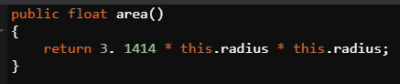
this Keyword
Even if there is no ambiguity, there is no harm in using this operator whenever you want to use the instance variables.
this.radius refers to the instance variable of class Circle.

Slide 64

Types of Constructors
Types of Constructors
Constructors are of two types:
Parameterized constructor
Default constructor

Slide 65
Types of Constructors
Parameterized Constructor
A constructor that has parameters is known as a parameterized constructor. A parameterized constructor is used to assign different values to the instance variables of distinct objects.
class name(___ , ___, .....)

Slide 66
Types of Constructors
Default Constructor
A constructor that has no parameter and does nothing apart from creating a new object is known as a default constructor.
It is a method that need not be declared if there is no parameterized constructor. The compiler will declare it itself whenever the object for that class is created.
class name( )

Slide 67
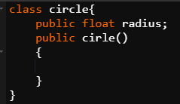
Types of Constructors
You can also declare it yourself and leave it empty in case of a declaration of other parameterized constructors.
When an object will be created with no parameters, then this default constructor will be called and the value of instance variable radius will be zero.

Slide 68
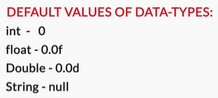
Types of Constructors
This is because default constructors
assign default values to the
instance variables of the objects
depending on the type, for
example, 0, null, etc.

Slide 69
Summary
Object Oriented Programming gives you a particular methodology for implementing large and complex programming projects in a very
simple way.
Class is a blueprint of an application where you Implement methods to perform certain actions/functionalities and declare variables that describe the properties of the application.
Objects are a basic unit of Object Oriented Programming which has a state and a behavior. An object's state is stored in fields and behavior is shown via methods.

Slide 70
Summary
We have seen that multiple objects can be created from a single class and we use constructors which is a special type of method
to initialize an object of a class and define values of the instance variables of the object.
The 'this' keyword is often used in classes to refer to instance variables. It is used to distinguish the instance variables from parameters inside a method that has the same name as the instance variable.

Slide 71

Thank you!
#LifeKoKaroLift

